Slide 1
System Software
4
Chapter 4

Slide 2
Learning Objectives
Describe the differences between system software and application software.
Identify the four types of system software.
Explain the basic functions, features, and categories of operating systems.
Compare mobile operating systems iOS, Android, and Windows Phone.
Compare desktop operating systems including Windows, Mac OS, UNIX, Linux, and virtualization.
Explain the purpose of utilities and utility suites.
Identify the four most essential utilities.
Describe Windows utility programs.

Slide 3

Introduction
Computers and computer applications have become a part of the fabric of every day life
They are great as long as they are working
We give little thought to the processes and programs running behind the scenes to keep them functioning effectively.
Such programs (i.e. operating systems, utility programs, and device drivers) are the system software you learn about here.

Slide 4
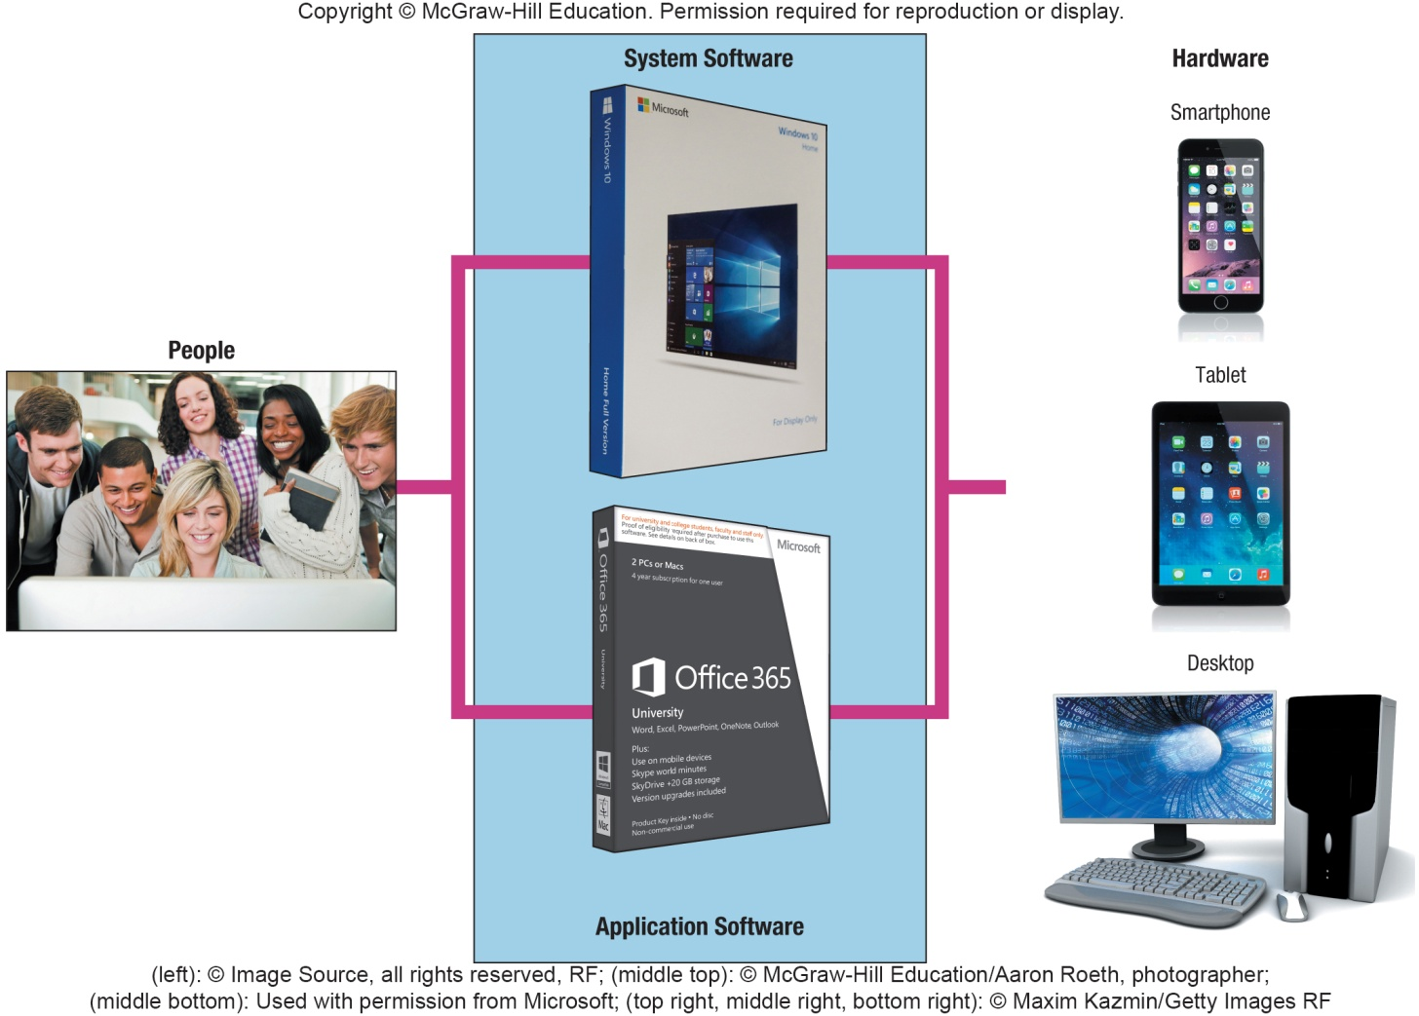
System Software
Works with end users, application software, and computer hardware
Handles the technical details
Includes
operating system
utilities
device drivers
language translators
Notes:
System software (key term) is not a single program but is a collection of programs that handles hundreds of technical details
End-users focus on application programs more than the system software, but it is important to understand how system software works
Four types of programs:
Operating systems (key term) coordinate computer resources
Utilities (key term) perform tasks related to managing the computer resources
Device drivers (key term) programs that allow devices to communicate with the computer system
Language translators (key term) converts programming instructions into a language the computers understand

Slide 5
Operating Systems
A collection of programs that handle technical tasks
Functions
Manages computer resources
Coordinate memory, processing, storage, printers and monitors
Monitor system performance
Schedule tasks
Provide security
Start-up the computer
Provides user interface
Graphical user interface (GUI)
Runs applications
Multitasking
Foreground and background applications
Notes:
Operating systems (key term) collection of programs that handle technical tasks
Sometimes referred to as software environment or platform
User interface (key term) and graphical user interface or GUI (key term)
Multitasking (key term) – the ability to switch between applications
Foreground (key term) – the program you are currently working on
Background (key term) – the other program that is running but not the active window

Slide 6
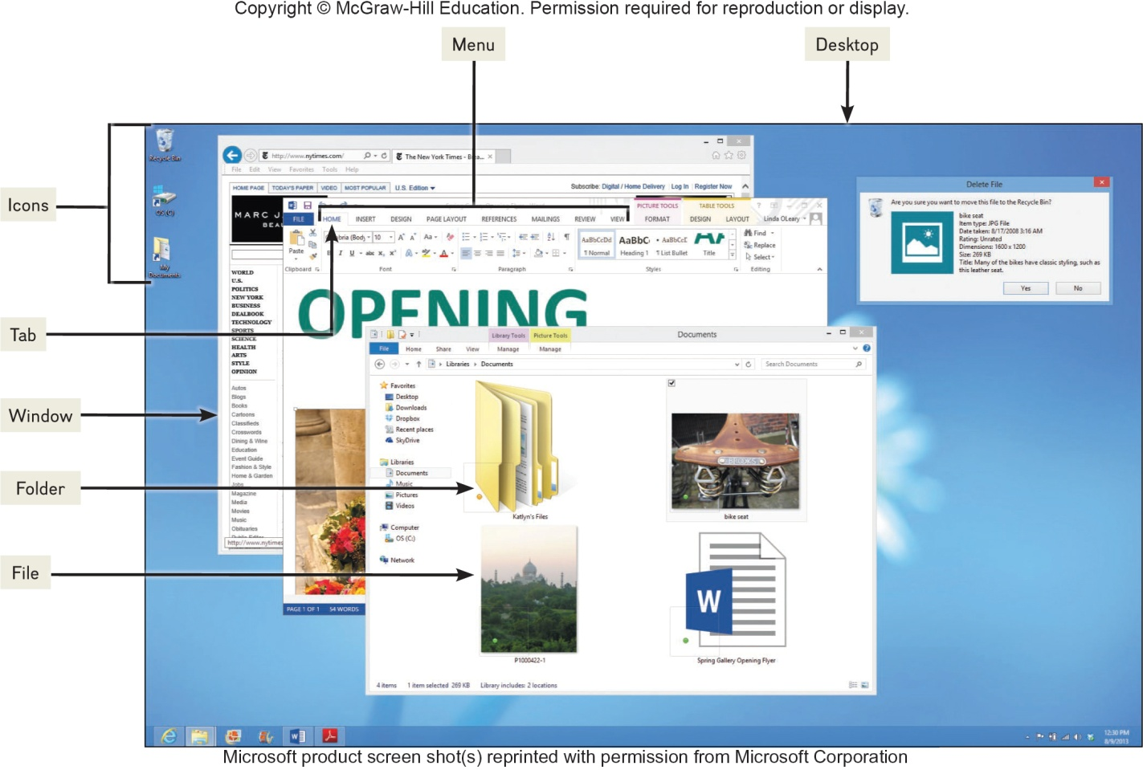
Features of an Operating System
Booting – starting or restarting the computer
Features in common with application software
Icons
Pointer
Windows
Menus
Tabs
Dialog boxes
Help
Gesture Control
Files and Folders
Files share data and programs
Folders store related files
Notes:
Booting (key term) is the process of starting a computer
Warm boot (Key Term) – computer is already on and you restart it without turning off the power
Cold boot (Key Term) – starting a computer that has been turned off
Common features in application software:
Gesture Control (key term) is the ability to control operations with finger movements: i.e. swiping, sliding and pinching
Most operating systems store data and programs in system files (key term) and folders (key term)
Files and folders
Files share data and programs
Folders store related files

Slide 7
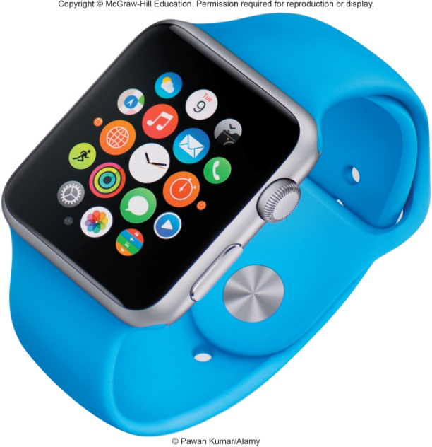
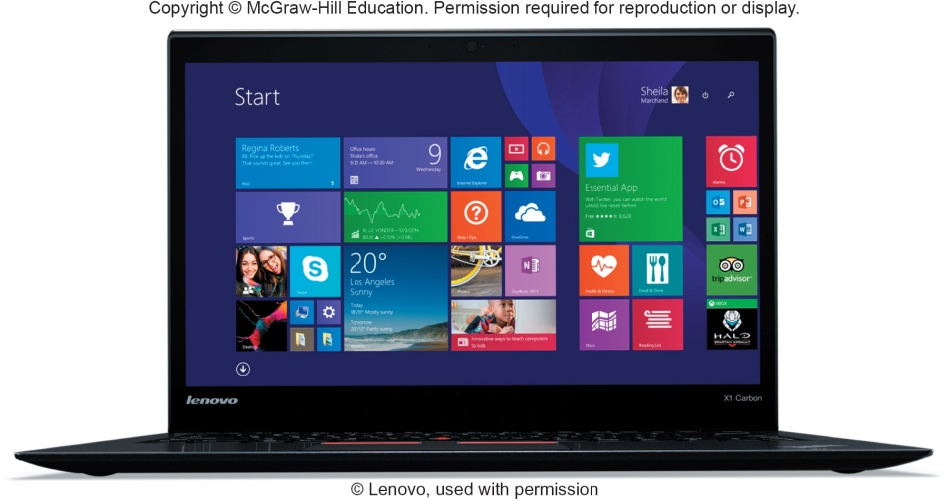
Categories of Operating Systems
Three basic categories
Embedded operating systems – RTOS (real-time operating systems)
Smartphones
Smartwatches
Video game systems
Stand-alone operating systems
Also called desktop operating system
Network operating systems (linked computers)
Windows Server, Linux, Unix
OS stored on network server which coordinates all communication between the other computers
Notes:
Three basic categories of operating systems:
Embedded OS (key term) – used for handheld devices
RTOS – real-time operating system
Stand-alone (key term) – or desktop operating systems (key term) – control a single desktop computer
Network operating systems (NOS) (key term) – control and coordinate networked computers. OS is stored on the network server (key term)
Operating system is often referred to as the software environment (key term) or software platform (key term) almost all OS’ are designed to run only on specific platforms

Slide 8
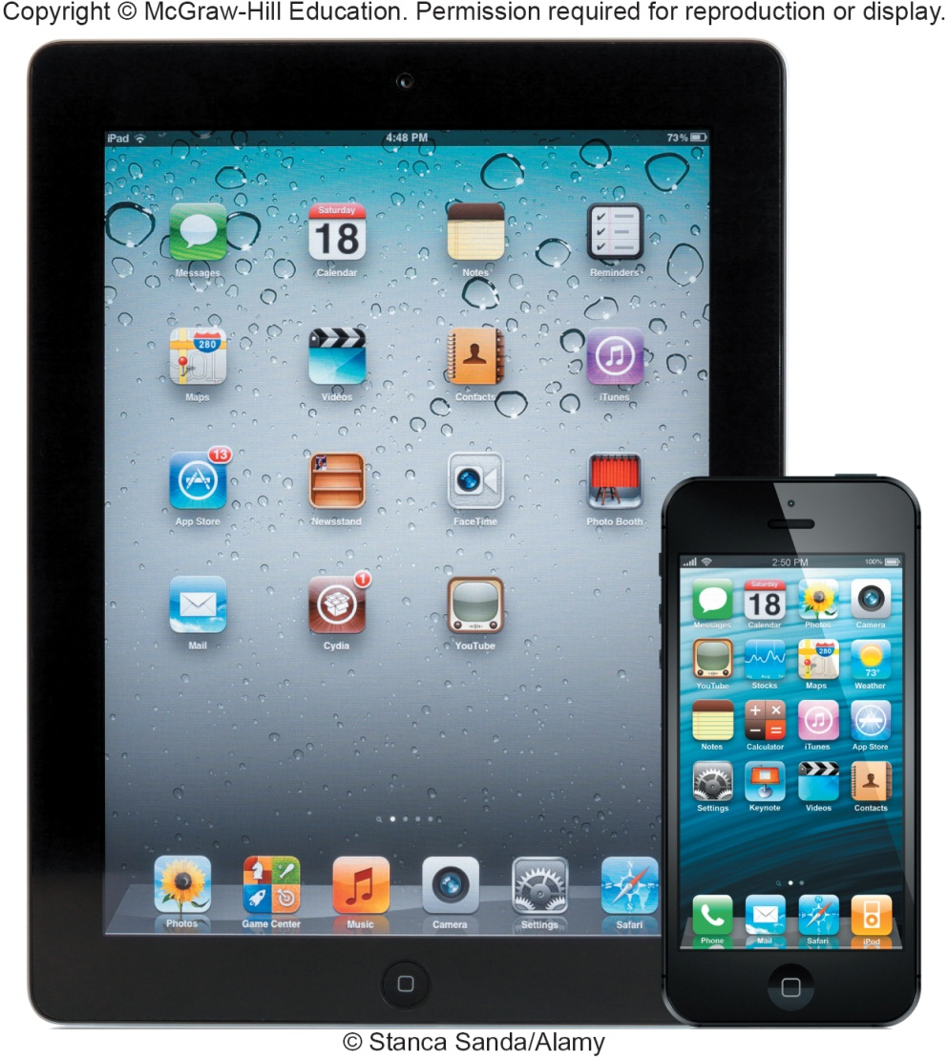
Mobile Operating Systems
Mobile OS
Embedded operating system
Less complicated and more specialized for wireless
Some of the best known
Android
iOS
Windows Phone
Notes:
Mobile operating systems (key term) also known as mobile OS (key term) are embedded OS that are less complicated and more specialized for wireless technology
Android (Key term) – owned by Google
iOS (key term) - formerly iPhone OS (key term) , iPad and iPhone
Windows Phone (key term) – introduced by Microsoft to support a variety of devices including smartphones

Slide 9
Desktop Operating Systems
Operating systems commonly used by individuals
Windows – most widely used
Mac OS – powerful and easy to use
UNIX – network; originally designed for Web
LINUX – non proprietary; free from the Web

Slide 10
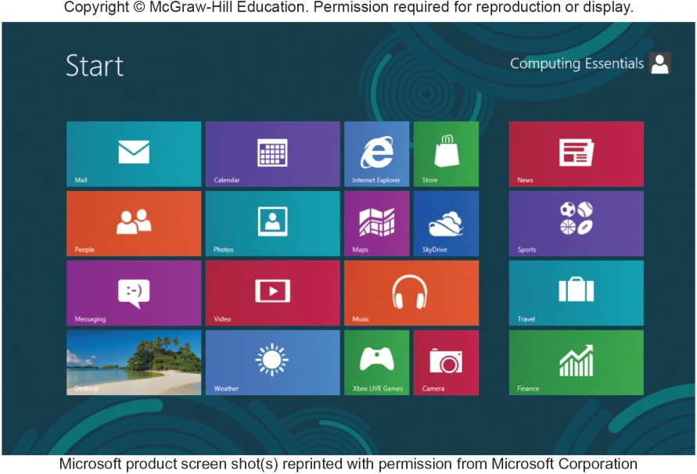
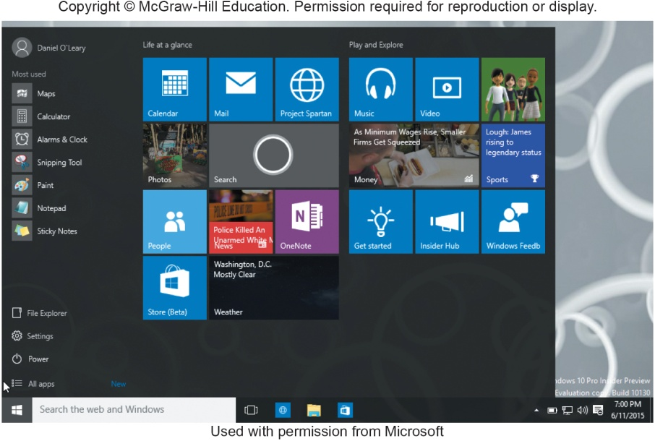
Windows - Most Used OS
Windows 8
Windows 10
Integrates the desktop OS with its mobile OS
Merges Windows desktop and mobile operating systems
Notes:
Windows (key term) most widely used microcomputer
Windows 8 (key term) – integrated desktop and mobile. Released in 2012
Uses tiles (key term) to display active content linked to applications
Tiles can be accessed through the start screen (key term)
Can still get the traditional desktop, Windows RT (key term), to run on the tablet
More application programs are designed to run under Windows than any other operating system
Windows 10 (key term) runs on all Windows devices
Cortana (key term) is a digital assistant that accepts voice or text

Slide 11
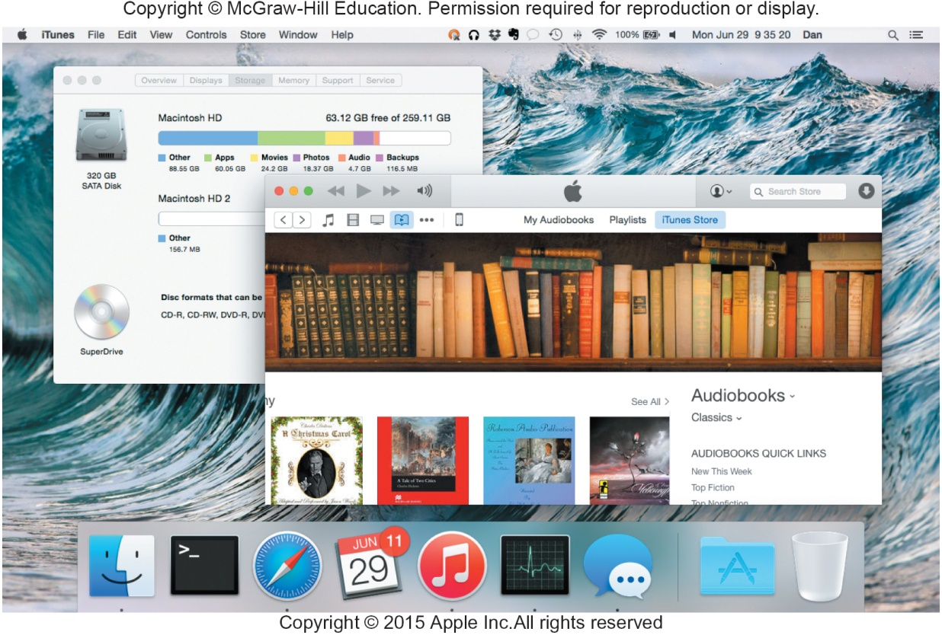
Mac OS
Mac OS X runs on Apple computers
Two most recent versions:
OS X Mavericks
Improved power management
OS X Yosemite
New user interface
Notes:
Mac OS (key term) – not as widely used as Windows, designed to run on a MAC
Fewer programs written for it
Mac OS X (key term) – most widely used MAC OS; has two versions.
OS X Mavericks – released in 2012
OS X Yosemite – new user interface

Slide 12
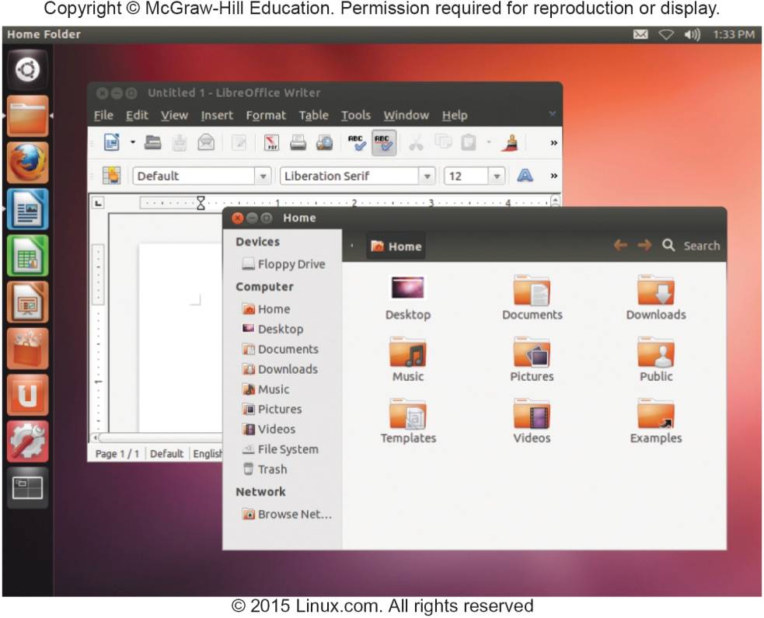
UNIX and LINUX
UNIX operating system
Servers on the Web
Mainframe computers
Personal Computers
LINUX - version of UNIX
Alternative to windows
Open source - free
Google Chrome OS based on Linux
Focuses on Internet connectivity and cloud computing
Speed is determined by the speed of the Internet
Notes:
UNIX (key term) – originally designed to run on minicomputers but now is used in network environments
Used by powerful microcomputers and by servers on the Web
There are a large number of different versions of UNIX
LINUX – operating system that is an extension of UNIX versions
Free distribution of the operating system code – Open source (key term)
Google’s Chrome OS (key term) is based on Linux

Slide 13
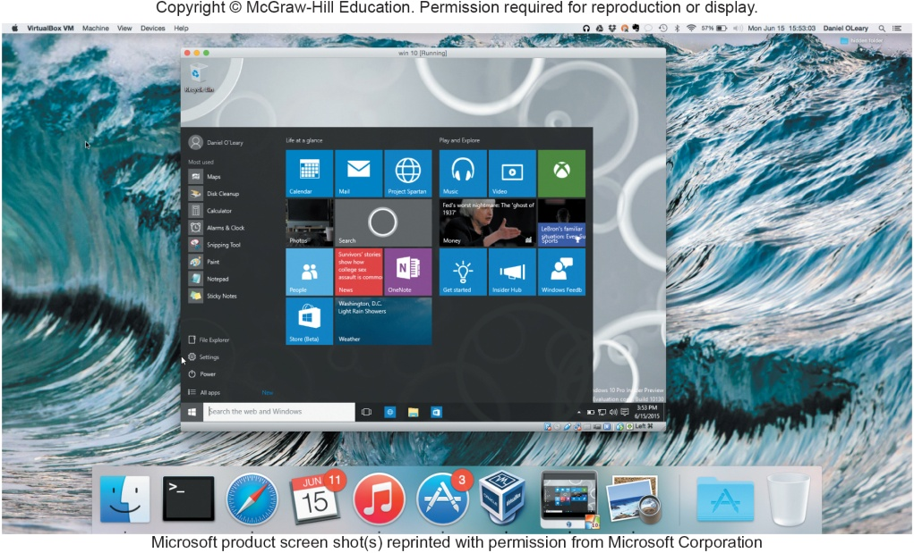
Virtualization
Ability to support multiple operating systems on a single physical machine
Virtualization software
Each virtual machine appears as a separate independent computer
Host operating system
Guest operating system
Parallels
Mac to run Windows programs in OS X
Notes:
Virtualization (key term) – supporting multiple OS that operate independently by running virtualization software (key term)
Each OS is known as a virtual machine (key term)
Host operating system (key term) - OS of the physical machine
Guest operating system (key term) - OS of virtual machine
Parallels (key term) is an example of a virtual software program that allows Mac to run Windows programs in OS X

Slide 14
Utilities
Specialized programs to make computing easier
Most essential utilities
Troubleshooting or diagnostic programs
Recognizes and correct problems
Antivirus programs
Guard your computer against viruses
Backup programs
Copies of files to restore if necessary
File compression programs
Reduces the size of files for more efficient storage
Notes:
Utilities (key term) – specialized programs designed to make computing easier
Troubleshooting program (key term) or diagnostic program (key term) recognize and correct problems
Antivirus program (key term) guard your computer against viruses
Backup program (key term) makes copies of files to restore if the originals are damaged
File compression program (key term) reduces the size of the file requiring less storage space

Slide 15
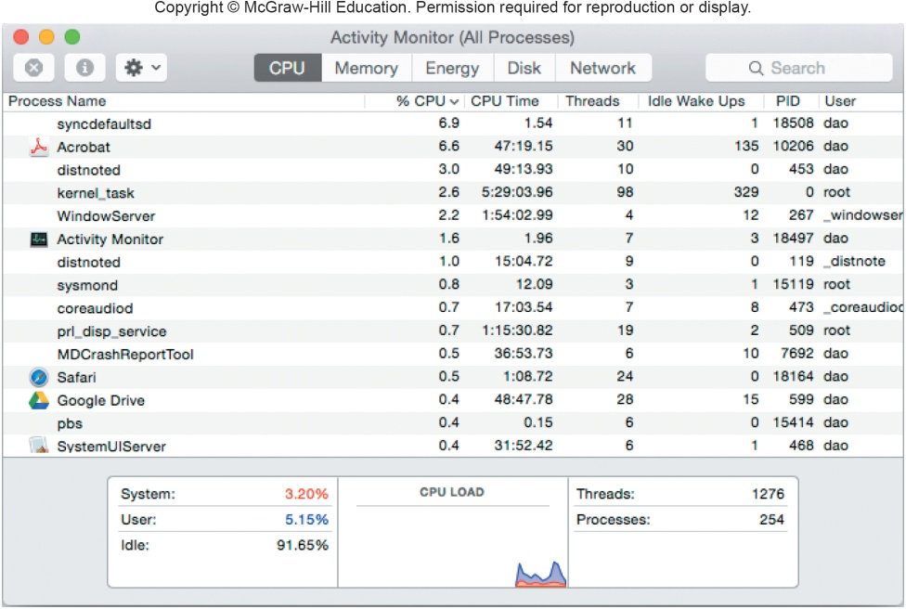
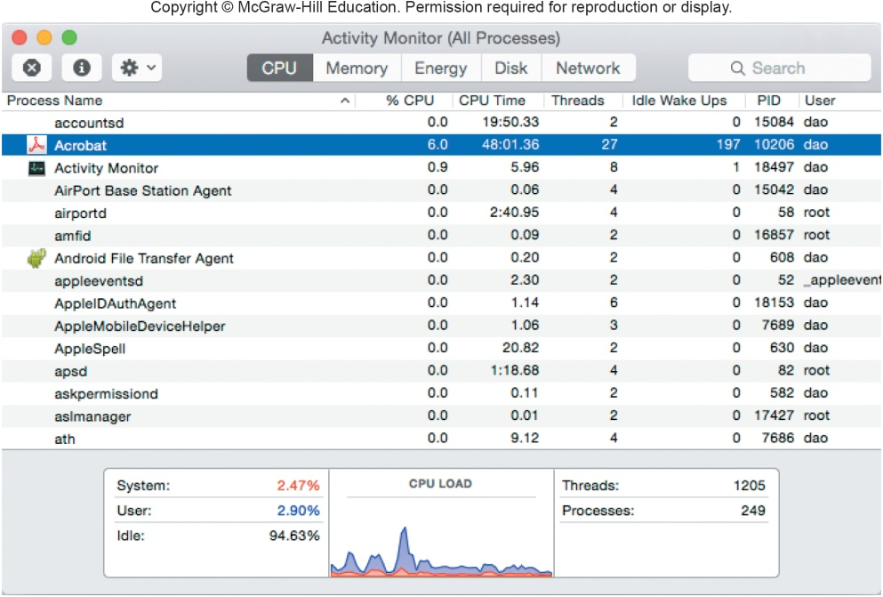
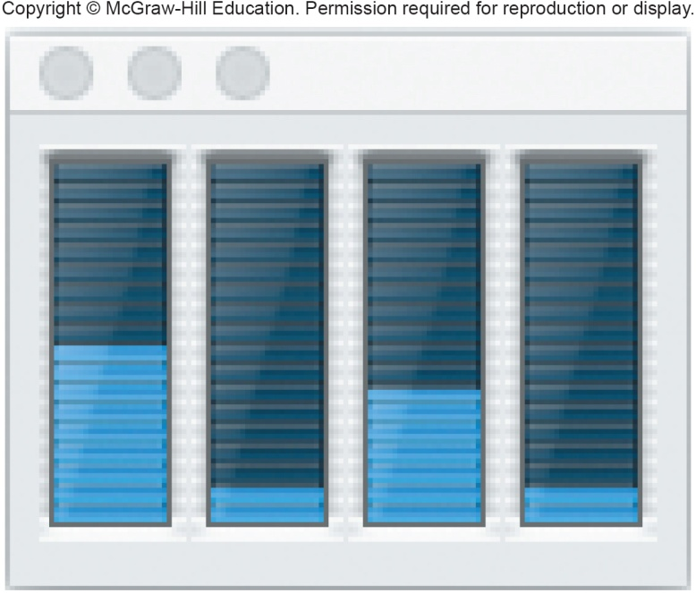
Making IT Work for You – Mac OS X Activity Monitor
Has your computer ever just stopped responding? What do you do?
Mac OS X Activity Monitor is designed to help.
Notes:
Mac OS X Activity Monitor gives you a view of every program that is currently running in RAM.
Press and momentarily hold the space bar
Type Activity Monitor and press return

Slide 16
Windows Utilities
Windows Operating Systems includes utilities such as:
File History
Can create a backup for your hard drive
Disk Cleanup
Identifies and eliminates non essential files
Disk Defragmenter
Rearranges files and unused disk space to optimize performance
Notes:
File History (key term) – can create a backup for your hard drive
Disk Cleanup (key term) identifies and eliminates non essential files
Disk Defragmenter (key term) rearranges files and unused disk space to optimize performance

Slide 17
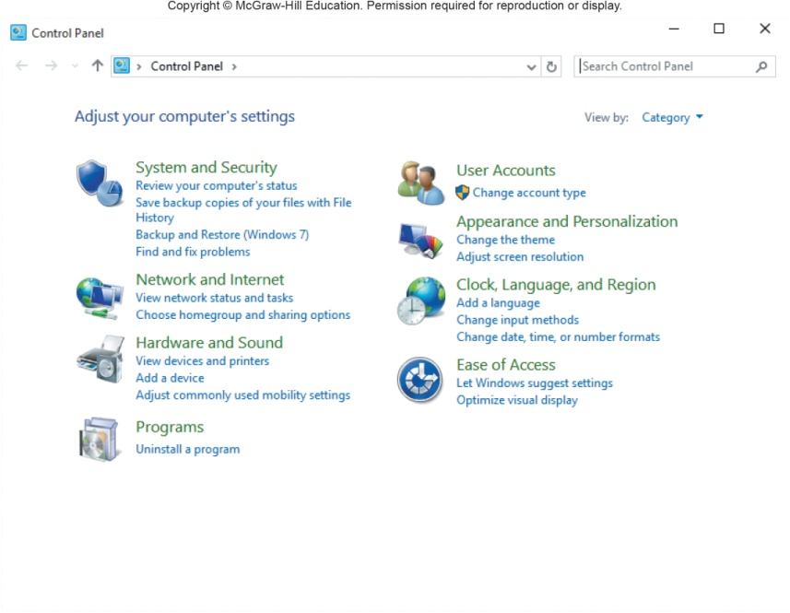
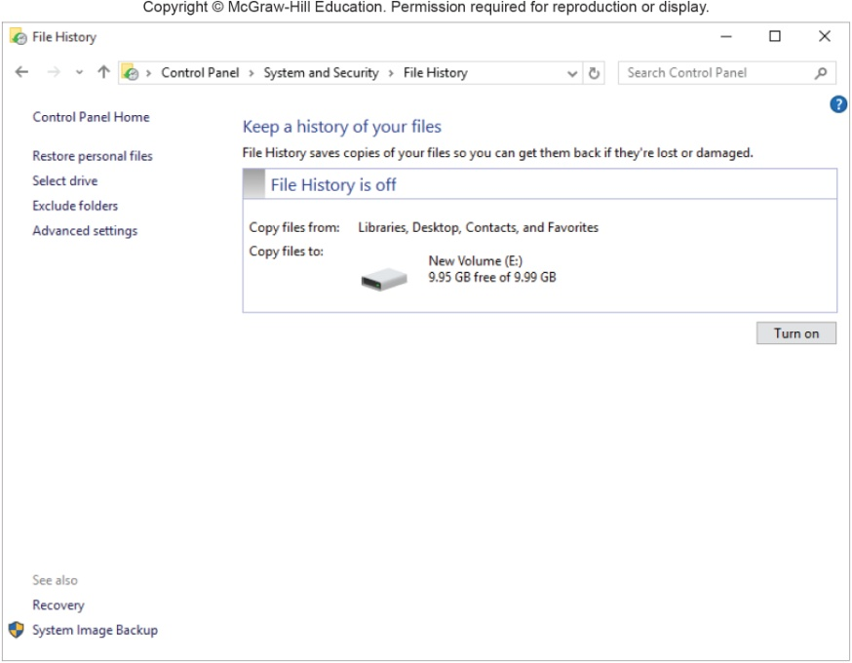
File History
Utility program included with Windows 8
Makes a copy of all files in the libraries, contacts, favorites and the desktop
Helps prevent the effect of disk failure
Notes:
You can select File History from the Windows 8 System and Security window and create a backup for your hard disk.

Slide 18
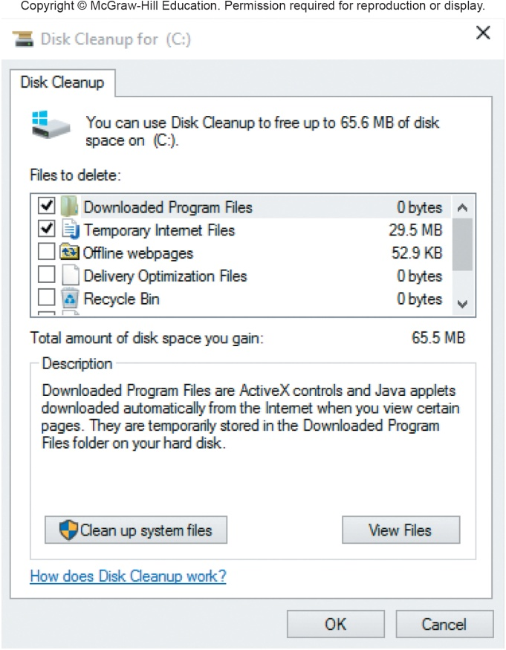
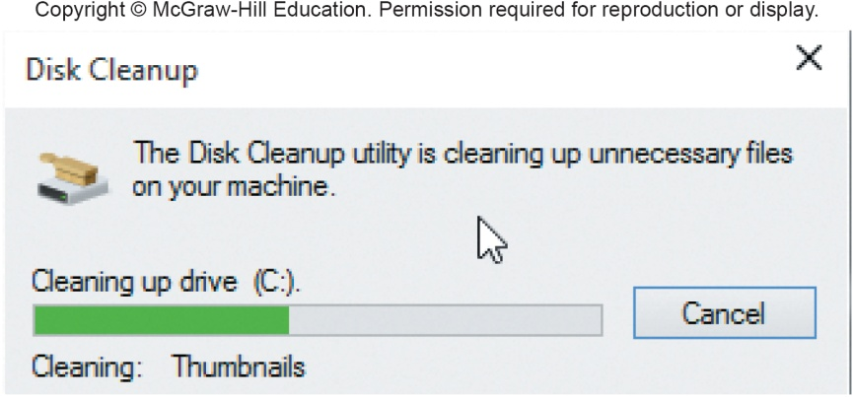
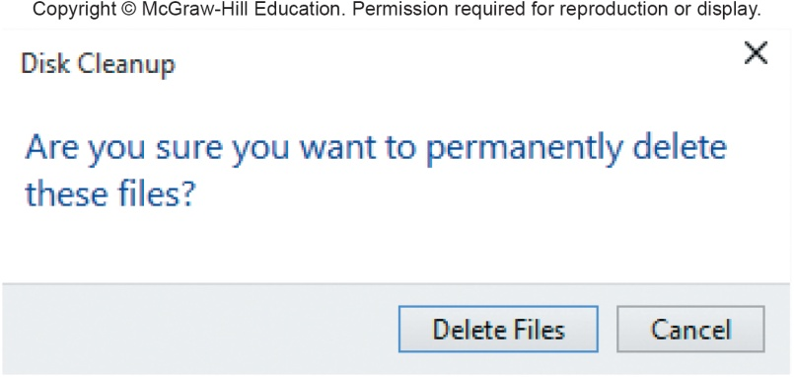
Disk Cleanup
Identifies and eliminates nonessential files
Frees up valuable space and improves system performance
Notes:
When you search the Web, a variety of programs and files are saved to your hard drive
Use disk cleanup (Key Term) to get rid of these unnecessary files

Slide 19
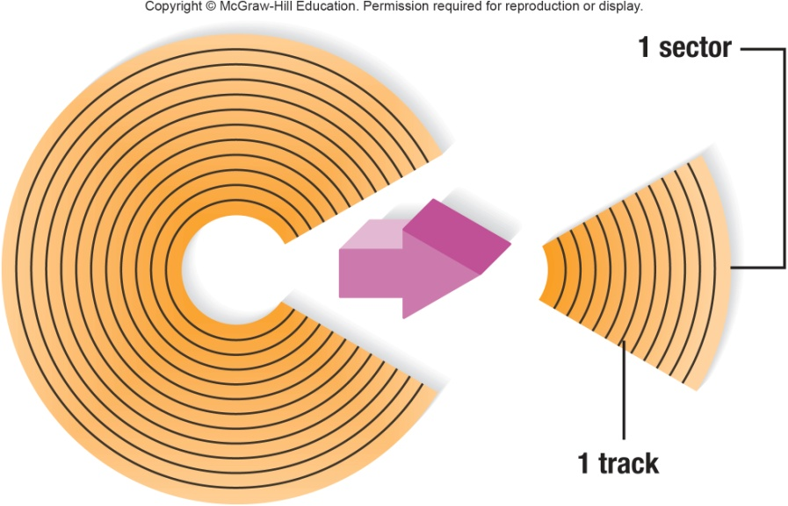
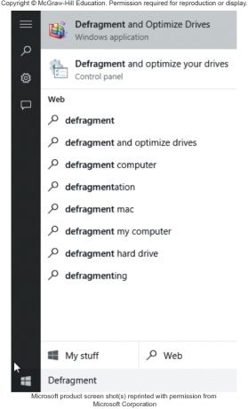
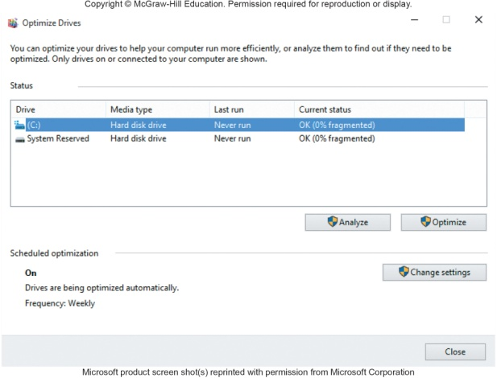
Disk Defragmenter
Files are organized in tracks and sectors
Tracks – concentric ring
Sectors – wedge-shaped sections of a track
Optimize drives - utility program
Identifies and eliminates unnecessary fragments
Files become fragmented
Broken up and stored in non contiguous space
Rearranges files and unused disk space to optimize operations
Notes:
Files are stored and organized on a disk according to tracks and sectors
Tracks (Key Term) – concentric ring
Sectors (Key Term) – wedge-shaped sections of a track
OS tries to save a file on a single track across contiguous sectors. Often the file has to broken into small parts and stored wherever space is available and the disk over time becomes fragmented (key term)
Disk Defragmenter (Key Term) should be run on your computer often
Some end-users run this utility program daily, while some run it once a week
Fragmented (Key Term) files - result of a file having to be broken apart into smaller parts so it can be stored wherever space is available

Slide 20
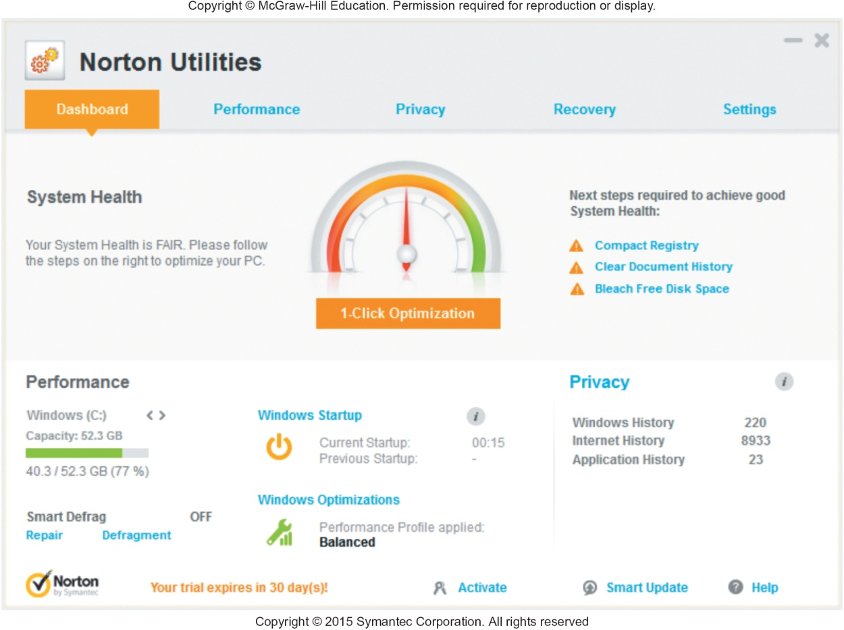
Utility Suites
Combine several programs into one package
Less expensive
Popular suites
Bit Defender
Norton Utilities
Kaspersky
Notes:
Utility Suites (key term) combine several programs into one package
Suites provide a variety of utilities:
Programs to protect your system against viruses (key term)

Slide 21

Careers In IT
Computer Support Specialist or Technical Support Specialist
Provide technical support to customers and other users
Resolve common networking problems and use troubleshooting programs to diagnose problems
Employers look for an advanced associate degree or bachelors degree, good analytical, customer service, communication and people skills
Computer support specialist can expect to earn $29K - $40K annually

Slide 22

A Look to the Future – Self Healing Computers
Self Healing Computers
Could mean an end to computer crashes and performance problems
Fix software problems
Reroute functions around broken hardware
IBM’s Automatic Computing Initiative (ACI)
Handles time-consuming maintenance
Self-regulating and virtually invisible
Self-maintaining servers
Self-repairing
Self-updating
Self-protecting

Slide 23
Open-Ended Questions (Page 1 of 2)
Describe system software. Discuss each of the four types of system programs.
Define operating systems. Describe the basic features and the three categories of operating systems.
What are mobile operating systems? Describe leading mobile operating systems.
Notes:
Have students turn to the end of Chapter 4 in their textbooks to view the same “Open-Ended” questions/statements

Slide 24
Open-Ended Questions (Page 2 of 2)
What are desktop operating systems? Compare Windows, Mac OS, Linux and Chrome OS. Discuss virtualization.
Discuss utilities. What are the most essential utilities? What is a utility suite?
Notes:
Have students turn to the end of Chapter 4 in their textbooks to view the same “Open-Ended” questions/statements

